Slide 1
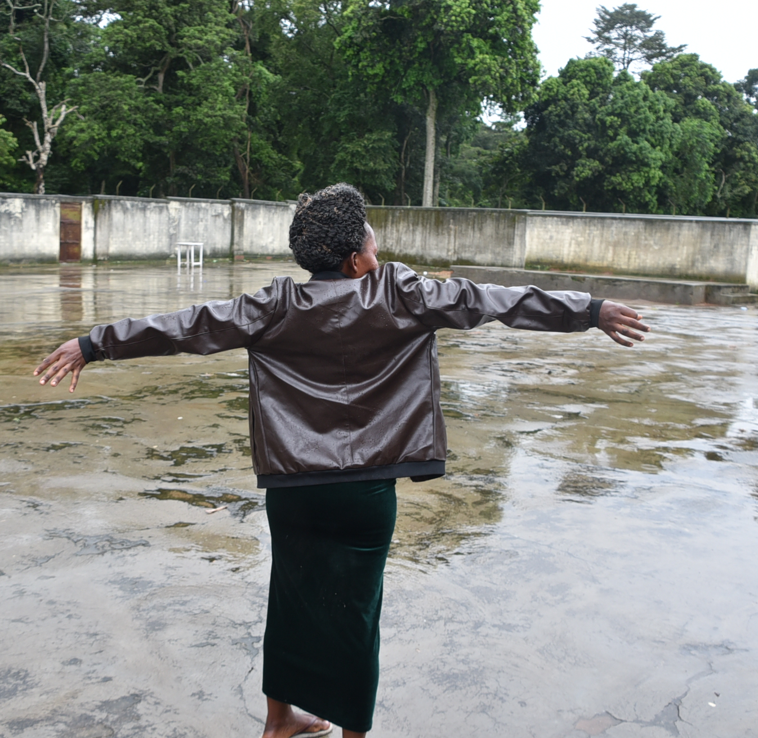
WPHF CfP information session for Ugandan organisations
13th September 2023

Slide 2
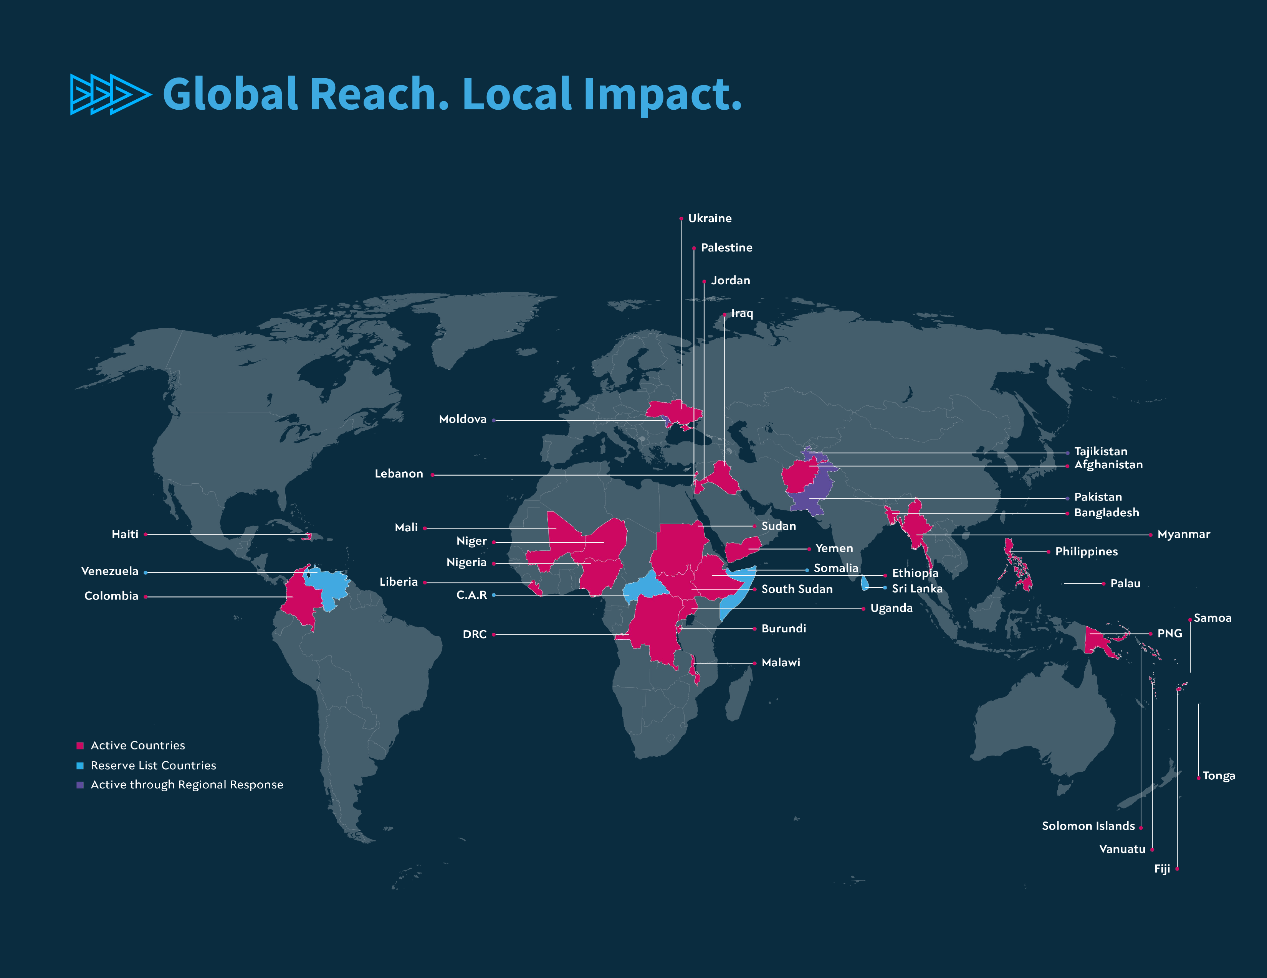

Slide 3
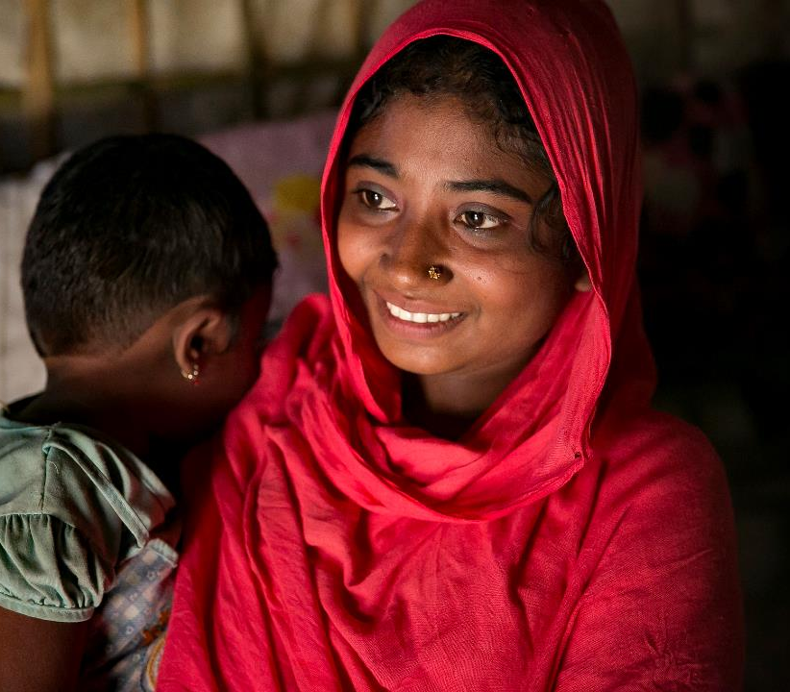
About WPHF
Established in 2016
Pooled funding mechanism and a partnership between UN agencies, Member States and civil society
Funds women civil society leaders and their local, grassroots organizations in conflict, post-conflict and humanitarian settings with average size of grants between 20,000 to 200,000 USD

Slide 4
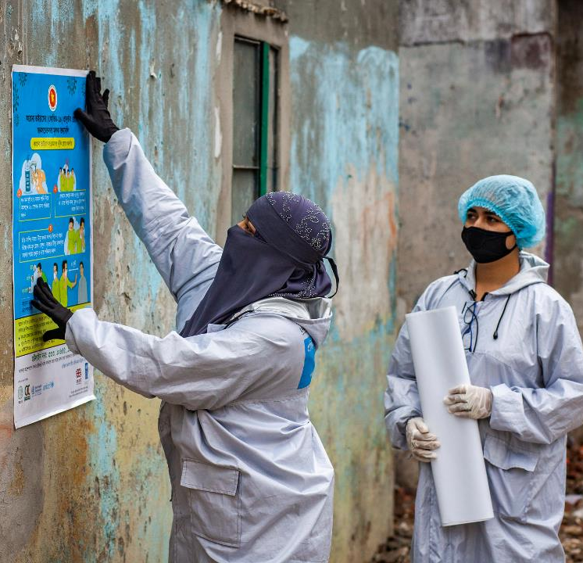
WPHF Functions
Breaking silos between humanitarian, peace, security and development finance by investing in enhancing women’s engagement, leadership and empowerment across all phases of the crisis, peace and security, and development continuum.
Addressing structural funding gaps for women’s participation in key phases of the crisis, peace and security, and development continuum by improving the timeliness, predictability and flexibility of international assistance.
Improving policy coherence and coordination by complementing existing financing instruments and promoting synergies across all actors: multi-lateral and bilateral entities, national governments’ women’s machineries; and local civil society organizations.

Slide 5
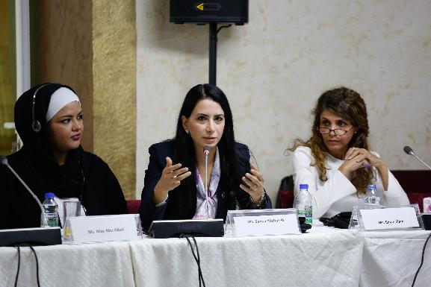
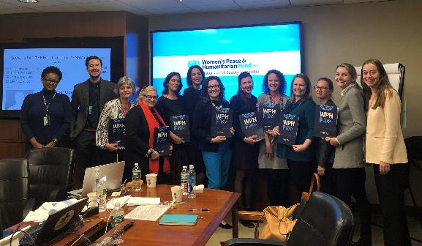
WPHF Governance
Global Funding Board with:
4 donor Member States (currently Germany, Norway, Italy and the United States)
4 UN Entities (currently UN Women, UNHCR, UNFPA and PBSO) representatives
4 Civil Society Organizations (currently Action Aid, Women’s Refugee Commission, Kvinna till Kvinna and the Feminist Humanitarian Network)
National Steering Committees (NSCs)
Management Entity for CSOs (UN Country Offices)
WPHF Global Secretariat

Slide 6
WPHF Key Numbers (Since 2016)
Country/Multi-country Allocations
Total Funds Mobilized
42
$ 149.9 million
Approved grants
CSOs Supported
583
1003
First-time UN-funded CSOs
Direct Beneficiaries (cumulative)
4.5 M (74% women & girls)
44.7%
Indirect Beneficiaries
31 M
As of 14 Aug 2023

Slide 7
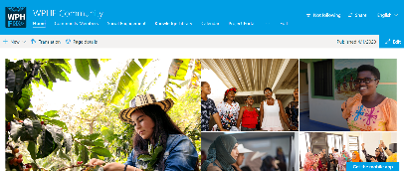
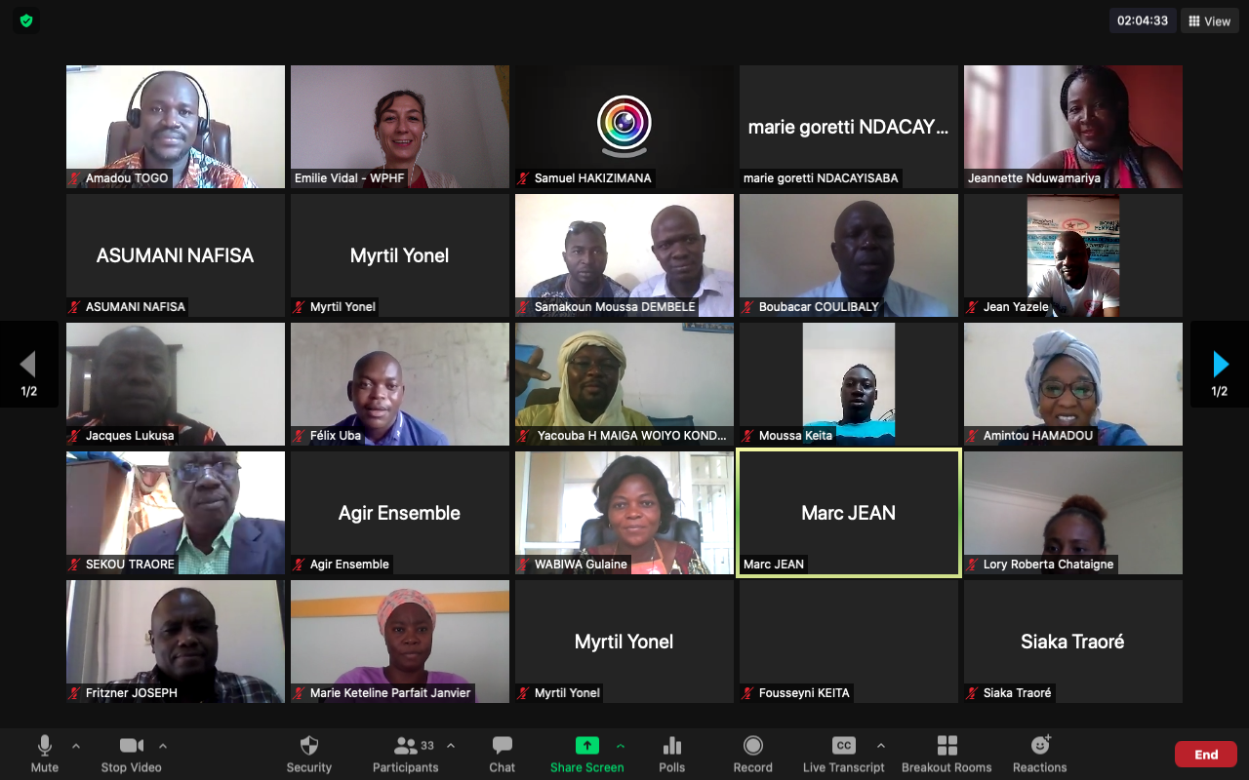
WPHF Global Learning Hub (L-HUB)
Building Community, Capacity & Knowledge Exchange for our Partners
In fulfillment of its mandate to serve as a global knowledge center for local civil society organizations (CSOs) working on the front lines of conflict and crises, WPHF established its Global Learning Hub (L-HUB) to enable CSO partners from across the world to connect, strengthen their networks, share best practices, and develop their skills and capacity.
The L-HUB constitutes the Capacity Building Programme, the Peer Exchange Series, the Digital Platform, the Facebook Group and email monthly updates.
To date, the L-HUB has engaged over 260 unique civil society organizations and 86.1% of CSOs reported using new knowledge and skills from WPHF capacity building programme.
The L-HUB has expanded to include the CSO Peer Learning Awards and the Mentorship Scheme leveraging the expertise of Germany's Action Network on Forced Displacement to provide training, knowledge exchange and mentoring opportunities to CSOs.

Slide 8
WPHF in Uganda
Active in Uganda since 2020 with Calls for Proposals in 2019, 2020, and 2023
26 projects, supporting 46 local women’s rights/led civil society organizations through a total of 3,478,581 (including COVID-19 Emergency Response Window & excluding CfP3)

Slide 9
Open Call for Proposals
4th September – 2nd October 2023

Slide 10
Objectives and Purpose of the Call for Proposals
The overall purpose of this call for proposals is to provide grants to local civil society organisations in Uganda.
The call for proposals specifically contributes to WPHF’s
Impact Area 2: Conflict prevention
Impact Area 5: Protection

Slide 11
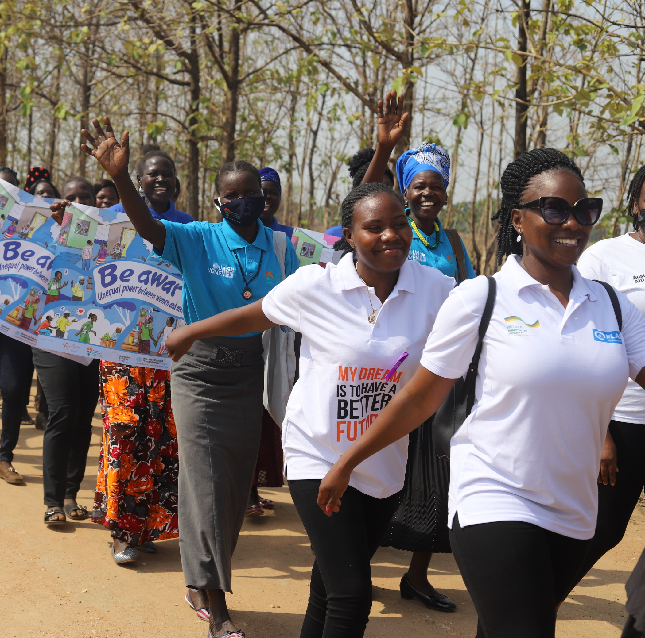
Scope
The WPHF will fund qualifying projects in any location in Uganda.
Multi-country projects, or projects outside of Uganda will NOT be accepted.
CSOs can apply for a maximum of 2 years.

Slide 12
Eligibility
Women's rights, youth rights, feminist, or civil society organisations with a strong track record in empowering women and girls, led by women or young women at the national, regional, or grassroots levels, are eligible to apply
Lead organisation must be registered in Uganda and be able to provide proof of registration.
Co-implementing partners and consortium members do not need a registration

Slide 13
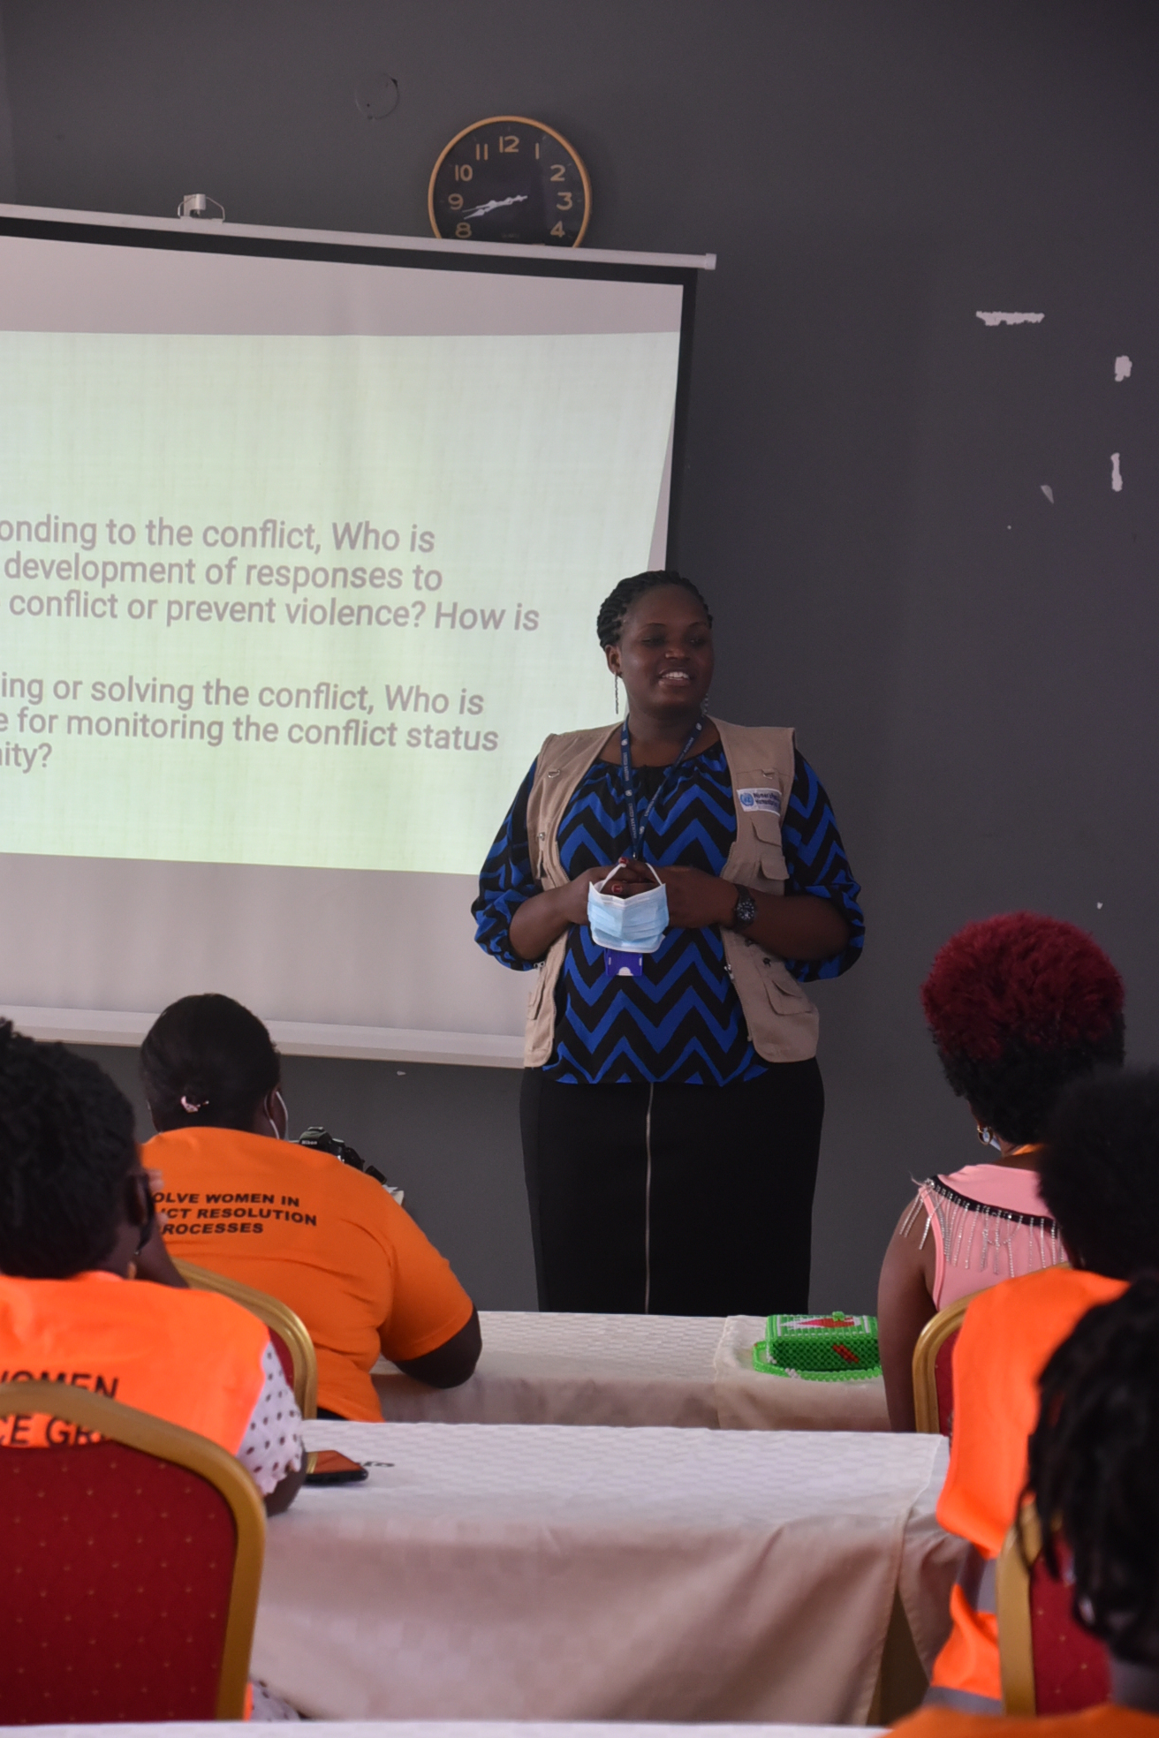
Eligibility
The following are NOT eligible to apply for a grant from the WPHF:
International non-governmental organisations;
Government agencies or institutions;
UN agencies or UN Country Teams;
Private individuals;
Private sector entities;
Universities, Think Tanks or Education or Research Institutions

Slide 14
Type of Funding and Requirements
An organization (lead applicant or co-implementing partners) can submit one application for institutional funding AND/OR one application for programmatic funding.
Institutional Funding: Stream 1 (USD $2,500 - $30,000)
Programmatic Funding: Stream 2 (USD $30,000 - $200,000)
Programmatic funding is for project focusing only on one impact area
WPHF Impact area 2: Increased meaningful participation and decision-making of women in conflict prevention processes and response
WPHF Impact area 5: Enhanced safety, security and mental health of women and girls’ and their human rights respected

Slide 15
Application Package and Procedures
Applicants are required to use only the WPHF templates provided in the link shared by UN Women Uganda
WPHF Proposal Template (attached, no more than 10 pages, excluding Annex A and B)
Results Framework (Proposal Template Annex: A) □ Project Budget (Proposal Template Annex: B) AND
Proof of valid legal registration or status of the lead organization (if you are in the process for renewal, please share proof)
DO NOT submit photos or additional documents other than the ones listed.

Slide 16
Application Package and Procedures
All documents should be submitted together as one package.
You may not make changes to your application after it is submitted.
Incomplete applications, or use of different templates will not be considered.
Please DO NOT resend your application unless you do not receive a confirmation of receipt within three days.
Application packages should be emailed to wphfapplications@unwomen.org by the 2nd October, 12:59 am Uganda time.

Slide 17
Useful information
Call for proposal available in English: https://wphfund.org/call-for-proposals-in-uganda/
Deadline: 2 October 2023 at 12.59 am (Uganda time)
Two funding streams:
Programmatic funding: 30,000 USD to 200,000 USD (Impact Area 2: Conflict Prevention & Impact Area 5: Protection)
To finance programmatic activities of CSOs aimed at enhancing the meaningful participation and decision-making of women in conflict prevention processes.
Institutional funding from 2,500 USD to 30,000 USD
To reinforce the institutional capacity of local civil society organizations
Organizations can apply for both funding submitting separate applications
Questions: isabella.bwiire@unwomen.org
Submissions: wphfapplications@unwomen.org

Slide 18
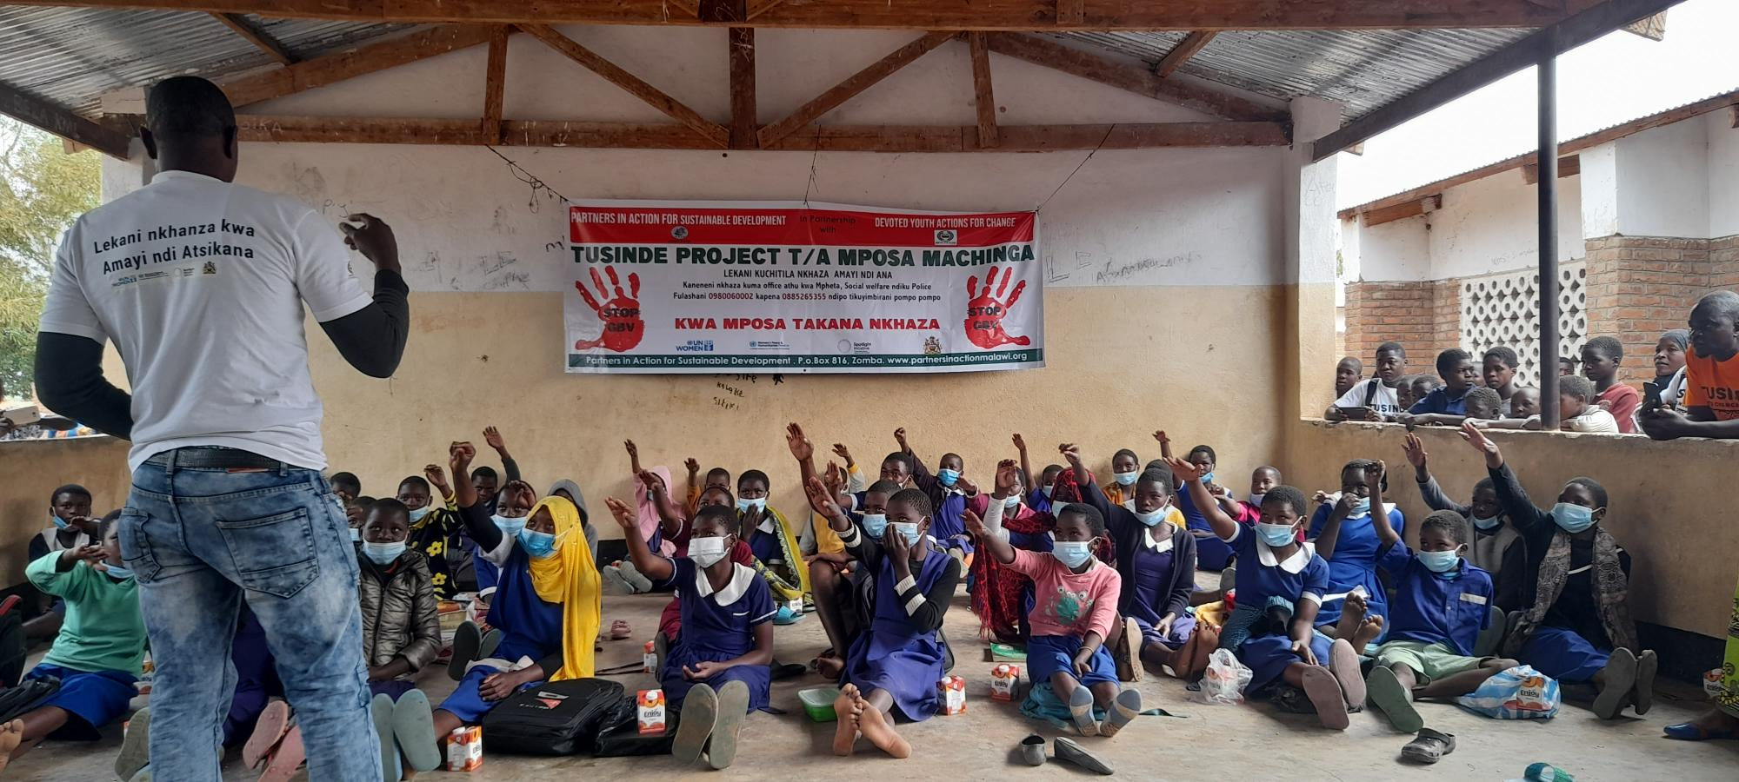
Frequently Asked Questions (FAQ)
MicrosoftTeams-image (14).png

Slide 19
Frequently Asked Questions (FAQ)
What are the criteria for eligibility?
The lead applicant organization must:
Have a proven track record working with women, young women and girls.
Have legal status with the competent national authority, be registered in the country and must submit proof of legal registration with the application package.
NOT ELIGIBLE are: International non-governmental organizations or organizations operating outside of Uganda, Government agencies/institutions, UN agencies, private individuals, private sector entities, and universities, think tanks or education/research institutions
Please note that eligibility will be assessed based on the registration certificate submitted with the application.
What should the focus of the projects be?
For Programmatic Funding: Projects should contribute to WPHF Impact Area 2: Increased meaningful participation and decision-making of women in conflict prevention processes and response, and its indicators (Please refer to the Indicator Tip Sheet for Conflict Prevention); or WPHF Impact Area 5: Protection of Women & Girls, and its indicators (Please refer to the Indicator Tip Sheet for Protection)
For Institutional Funding: Projects should focus on reinforcing the institutional capacity of the organization working on issues related to the WPS Agenda (Indicator Tip Sheet for Institutional Funding).

Slide 20
Frequently Asked Questions (FAQ)
Do we need to be legally registered as an organization in Uganda to apply?
YES, for the lead applicant. The lead applicant organization must have legal status with the competent national authority in the eligible country of project implementation and must submit proof of legal registration with the application package. Note that articles of incorporation are not proof of legal status. There is no minimum requirement for the registration period of the lead applicant.
NO for co-implementing or consortium partners. Co-implementing partners are not required to provide legal registration, only the lead applicant organization.
Does WPHF fund projects that target women of any age and intersectional characteristics?
Yes, WPHF encourages projects to reach women in all their diversity.
Are there any specific limitations for the budget categories of ANNEX B?
No, there is no specific budget limitation for each budget category, with the exception of the Indirect Support Costs which must not exceed 7% of the subtotal, also keeping in mind the maximum ceiling of USD 200,000 for programmatic funding and USD 30,000 for institutional funding.

Slide 21
Frequently Asked Questions (FAQ)
How does WPHF define Women’s Rights, Feminist, Women-Led, Youth Focused, and Young Women-Led Organizations?
Women’s Rights or Feminist Organization: The organization’s official mission/vision statement must reflect its commitment to addressing multiple/intersecting forms of discrimination and advancing gender equality and women’s rights. The organization must aim to address the underlying drivers/systems/structures, including patriarchy and gendered power dynamics, and work to transform these.
Women-Led Organization: must be headed by a woman as director/head of organization.
Youth Focused Organization: To be considered “youth focused", the organization's core mission/vision must focus on supporting the social, economic and political participation of young women and young men and addressing multiple/ intersecting forms of discrimination against young women and men. WPHF will provide specific attention to youth focused organizations supporting young women, advancing gender equality and peacebuilding.
Young Women Led Organization: must be headed by a young person aged between 18 - 29 years old who serves as director/head of organization

Slide 22
Frequently Asked Questions (FAQ)
Can INGOs submit applications in partnership with CSOs and/or CBOs as lead applicant or co-applicant?
International non-governmental organizations (INGOs) are not eligible to apply as lead applicants and can only be partners as co-implementing or consortium partners, if the lead applicant meets the eligibility criteria.
Can a CSO also apply on their own, without a consortium?
CSOs can apply without consortiums. However, partnerships with local civil society organizations are encouraged. UN Women only manages the lead applicant/organization, and the lead applicant/organization is expected to onboard the consortium.
If we are applying as a consortium, will only the lead organization be evaluated?
Only the lead applicant must meet the eligibility criteria but must demonstrate why this partnership is needed and its added value. For example, a lead organization might want to work with smaller organizations and strengthen their capacities in conflict prevention. Co-implementing partners must have specific roles in the project, which can include capacity building. Also, in a consortium, only the lead applicant will receive the funds, so it is the responsibility of the lead CSO to agree with the co-implementing partner(s) on the modality and amounts of transfers to the co-implementors, and this must be reflected in the budget. The lead applicant is responsible to the WPHF/UN Women in terms of managing the funds.

Slide 23
Frequently Asked Questions (FAQ)
Can we apply to both programmatic and institutional funding streams?
Yes. An organization (lead applicant or co-implementing partners) can submit one application for institutional funding AND/OR one application for programmatic funding. Organizations who apply for both institutional and programmatic funding need to submit two separate applications packages (in two different emails) based on the related templates of each stream.
Can we amend or change the formulation of impact, outcome and output statements or indicators?
You cannot change the formulation of the impact statement and impact-level indicators, and they must be used as they are in the Results Framework (Proposal Template Annex A). For the outcome indicator, you must use the two reach indicators (on direct and indirect beneficiaries) and develop your own outcome statement(s) and outcome-level and output-level indicators.
What should we put as the start dates of project implementation?
You can put November 2023 as a start date, but it can be later adjusted to align with the timeline of the selection and onboarding processes.
How many projects will be funded?
The number of projects funded will depend on the number of successful applications and the project budgets, as well as the total available budget.

Slide 24
Frequently Asked Questions (FAQ)
With regards to institutional funding, what are examples of capacity strengthening?
The funding is for you to strengthen your internal institutional capacities or equipment. It is demand-driven but examples can be related to developing M&E frameworks, risk management strategies, PSEAH policies, fundraising capacity strengthening, among others. It is very important to demonstrate how the current context affects the institutional and financial capacities and how the funding will support the implementation of the WPS Agenda. For other examples of activities that can be supported under institutional funding, please refer to the Indicator Tip Sheet for Institutional Funding.
Can institutional funding support the construction of offices for sustainability of operations?
Projects supported under institutional funding cannot include the construction of new office spaces. The rehabilitation of a space can be eligible.
What should be the geographic focus of the project and its beneficiaries?
The WPHF will fund qualifying projects in any district in Uganda. Multi-country projects, or projects outside Uganda will NOT be accepted. The number of areas focused on depends on your logistical capacity, and where you are based, and where you anticipate the needs.

Slide 25
Frequently Asked Questions (FAQ)
What should be included in the application package?
The application package must be sent in an email and must contain:
WPHF Proposal Template (no more than 10 pages, excluding Annex A and B)
Results Framework (Annex A in Proposal Template)
Project Budget (Annex B in Proposal Template)
Proof of valid legal registration or status of the lead organization (if you are in the process for renewal, please share proof)
Please note that you must not submit an excel budget breakdown with your application.
Are there limitations to the scope of the applicants’ proposals? For example, is there a specific type or number of ‘conflicts’ that applicants must target with their applications?
We will consider any project proposal developed in line with the impact statement of WPHF Impact Area 2: Increased meaningful participation and decision-making of women in conflict prevention processes and response OR WPHF Impact Area 5: Protection of Women & Girls. The scope is up to you to decide, depending on your mandate, your capacity/expertise, and the extent and geographical spread of the issue.

Slide 26
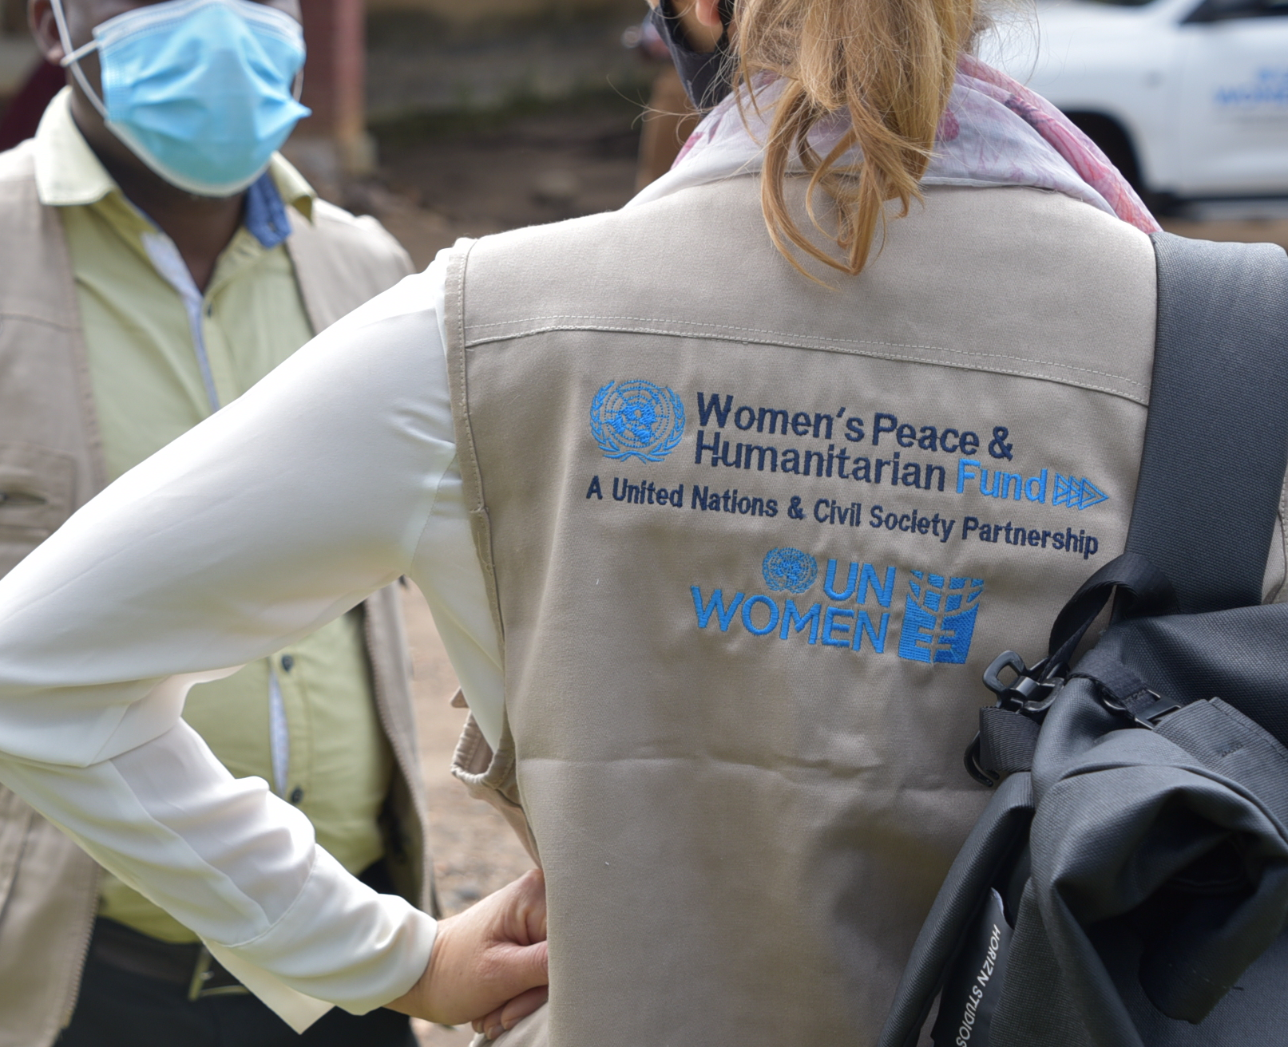
Thank you! @WPHFund
Notes:
Data as of March 30, 2021

